Slide 1
For NBA Lead Analysis
I have searched it in both Michigan Library and Google Scholar and I found there is no existed research in this topic. Therefore, I think what we will do is novel enough.
However, I do find some articles talking about NBA games in general, and I have read them thoroughly. I will try to summarize each article in the following pages. Since our topic are different from them, I will mainly focus on the methods to make sure we have the right level of complexity.

Slide 2
Evaluation of Competitive Performance Ability of Basketball Players Based on Hybrid Model
Indicator System Construction: Identifying evaluation indicators for sports intelligence through expert surveys and interviews, covering technical, tactical abilities, and competitive performance.
Applying AHP Method: Using AHP to determine the importance of various indicators, forming judgment matrices, and calculating the weight of each indicator within the sports intelligence evaluation system.
Intelligent Fuzzy Comprehensive Evaluation: After establishing the indicator system and weights through AHP, the study applied intelligent fuzzy comprehensive evaluation to assess the practical applicability of the system, using athletes from Shanxi University's men's basketball team as subjects for validation.

Slide 3
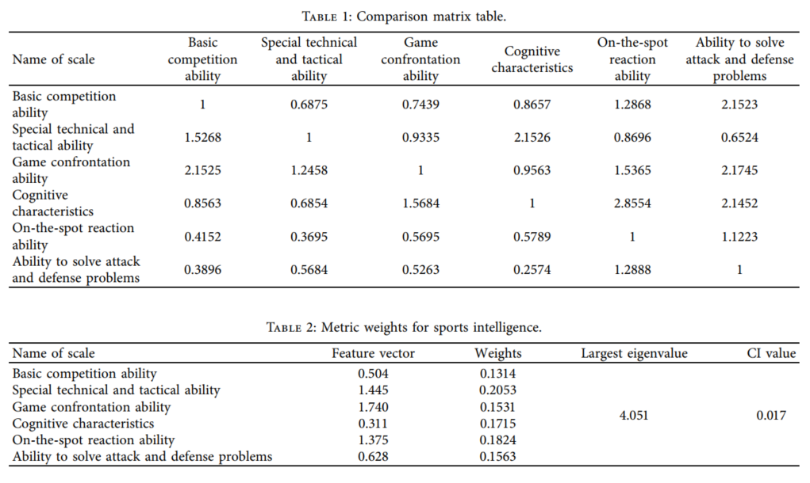
AHP Method

Slide 4
Exploring Game Performance in the National Basketball Association Using Player Tracking Data
Descriptive Discriminant Analysis: A statistical method used to determine which variables best differentiate between groups (e.g., all-star vs. non-all-star players), identifying key performance indicators critical for player performance classification.
K-Means Clustering Analysis: An unsupervised machine learning technique that groups data points into k clusters based on similarity, used to identify patterns in player performance data and create distinct performance profile groups.

Slide 5
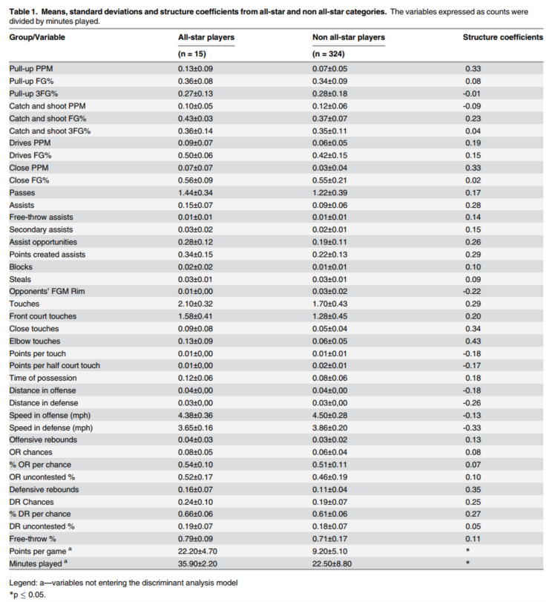
Descriptive Discriminant Analysis:

Slide 6
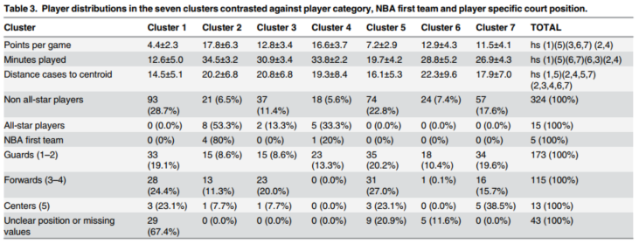
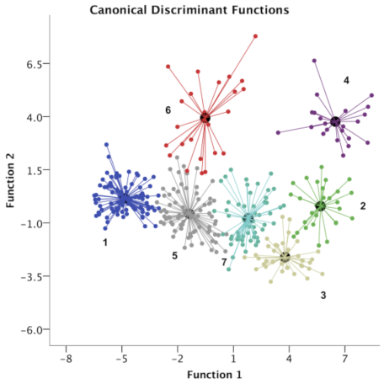
K-Means Clustering Analysis:

Slide 7
Predicting success in the National Basketball Association Stability and potential
Growth Mixture Model (GMM): analyze early career performance data of NBA players, classifying them into different latent developmental trajectory groups based on their performance.
The GMM approach is applied to classify players into latent classes based on their starting points and growth trajectories (intercept and slope). This method allowed the authors to predict NBA career success and draft order based on a set of collected variables, demonstrating the utility of GMM in understanding the dynamics of player development and success in professional sports.

Slide 8
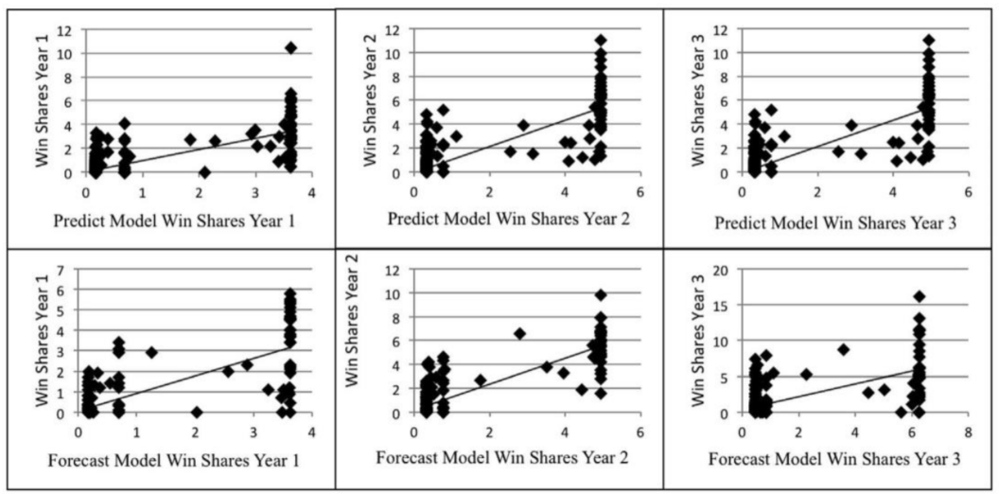
Growth Mixture Model (GMM):

Slide 9
Quantifying Training and Game Demands of a National Basketball Association Season
Regression analysis: used to establish strong relationships between the different data systems, allowing for the conversion of metrics between systems for consistent load quantification.
Statistical analysis: Data were summarized in weekly blocks and analyzed using mixed models. The analysis aimed to compare weekly integrated load and duration based on different player characteristics like playing position and years in the NBA.

Slide 10
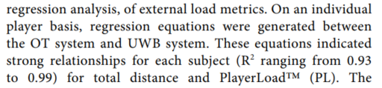
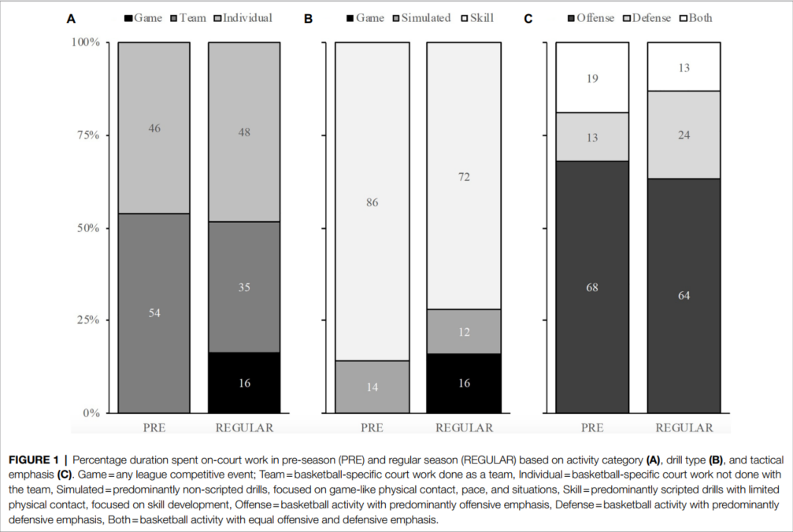
Regression analysis:
Statistical analysis:

Slide 11
Sports analytics — Evaluation of basketball players and team performance
Data Mining and Machine Learning: Employing algorithms like Random Forest, Adaboost, Multilayer Perceptron, Radial Basis Function Networks, and Association Rule-based models to analyze the data.
Performance Metrics Analysis: The study uses a range of basketball performance metrics to analyze and compare player and team performances.

Slide 12
Random Forest: This method is used to predict player performance and game outcomes by creating multiple decision trees and merging their results for more accurate and stable predictions.
Adaboost: It enhances the prediction models by combining multiple weak learners into a strong learner. This approach improves the accuracy of performance predictions and classifications.
Multilayer Perceptron (MLP): This neural network is used for complex pattern recognition, like identifying intricate patterns in player performance data, leading to insights about player abilities and potential.
Radial Basis Function Networks (RBFN): RBFN is utilized for its efficiency in classifying complex datasets. It helps in categorizing players based on performance metrics, revealing nuanced aspects of player skills and team dynamics.
Association Rule-based Models: These models find meaningful relationships between different variables in the data. They are used to uncover hidden patterns and correlations in basketball performance data, offering strategic insights.

Slide 13
The underpinning factors of NBA game-play performance: a systematic review (2001–2020)
Comprehensive literature search across multiple databases.
Setting specific inclusion criteria for selecting relevant studies.
Quality assessment and risk of bias evaluation for each study.
Data extraction and organization based on predetermined outcome measures.
Synthesis and interpretation of findings to identify key factors influencing NBA game performance.
No specific, common and generalized quantitative analysis methods have been found

